Slide 1

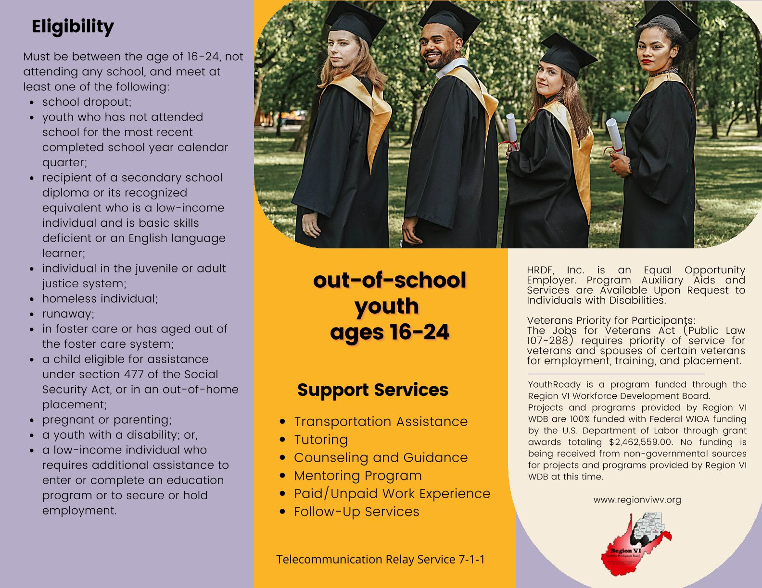
YouthReady Program
Helping Young Adults Prepare for Education & Employment
HRDF | WIOA Youth Program

Slide 2
What Is YouthReady?
WIOA-funded program for out-of-school youth ages 16–24
Supports education, training, and employment goals
Equal Employment Opportunity Employer/Program. Projects and programs provided by Region VI Workforce Development Board (WDB) are 100% funded with Federal WIOA funding by the U.S. Department of Labor through grant awards totaling $2,462,559.00. No funding is being received from non-governmental sources for projects and programs provided by Region VI WDB at this time.

Slide 3
Who Is Eligible?
Ages 16–24
Out of school
Must meet at least one eligibility barrier

Slide 4
Eligibility Barriers
School dropout
Justice system involvement
Homeless/runaway
Foster care
Pregnant or parenting
Youth with a disability
Low-income needing assistance

Slide 5
Support Services
Transportation assistance
Tutoring
Counseling & guidance
Mentoring
Paid/Unpaid work experience
Follow-up services

Slide 6
Education & Employment Support
GED or diploma completion
Job readiness skills
Career exploration
Training & work experience

Slide 7
Follow-Up Services
Provided for 12 months after program completion
Supports employment and education success

Slide 8
Veterans Priority
Veterans and eligible spouses receive priority of service

Slide 9
Service Areas
Serving multiple counties across North Central West Virginia
  Braxton, Gilmer, Lewis, Barbour, Randolph, Tucker, Upshur, Doddridge, Harrison, Taylor, Marion, Monongalia, and Preston Counties.

Slide 10
Contact Information
Caitlyn Wilson – cwilson@hrdfwv.org
Phone/Fax: (304) 637-0718 Cell: (301) 665-7313
Bethany McBee – bmcbee@hrdfwv.org
Phone: (304) 657-5698

Slide 11
Questions?
Thank you for your time!
Questions or referrals welcome

