Slide 1
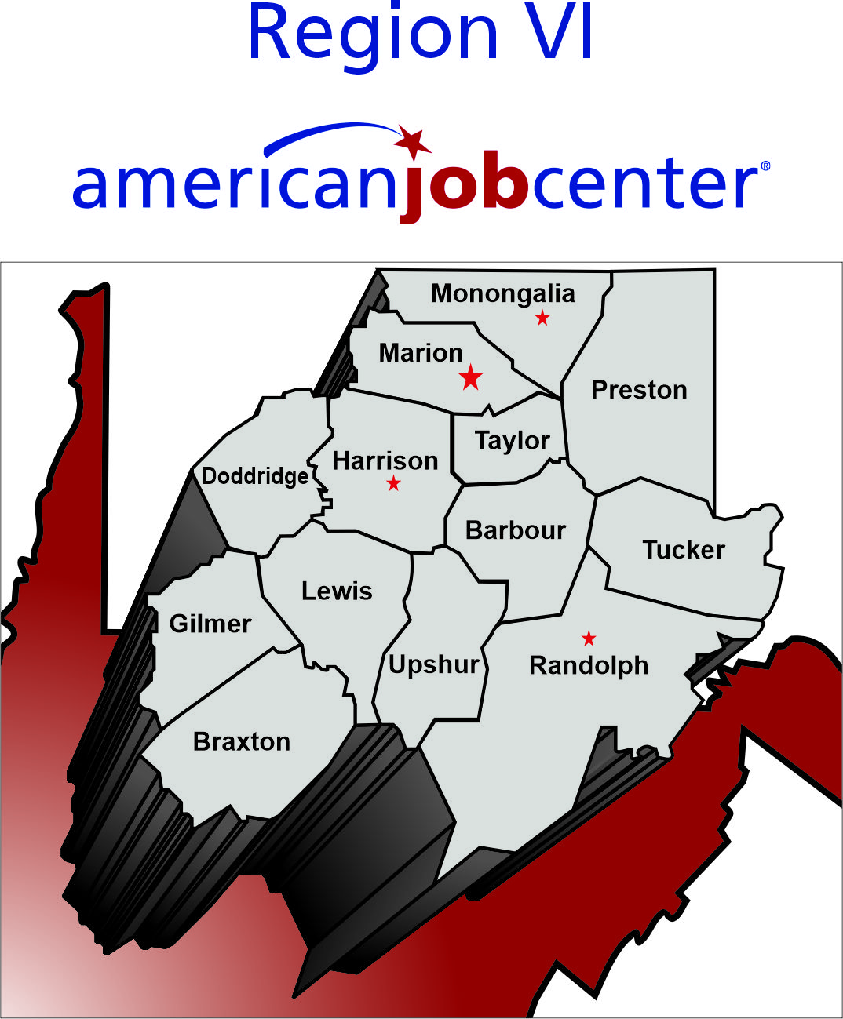
Region 6 Partner Network Review
April 10th 2025

Slide 2
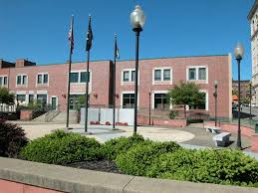
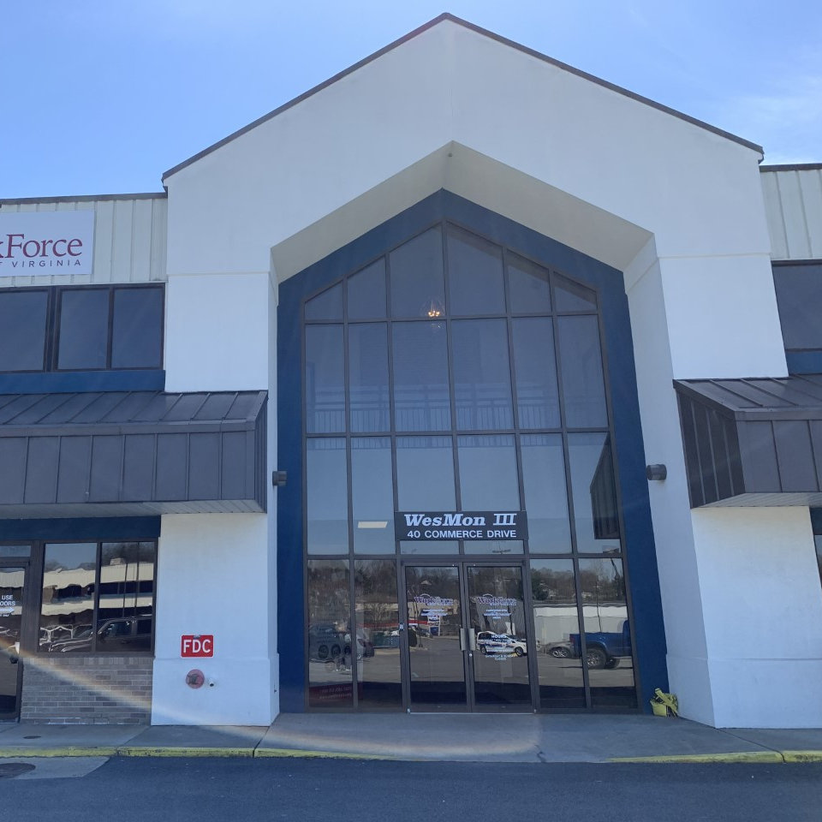
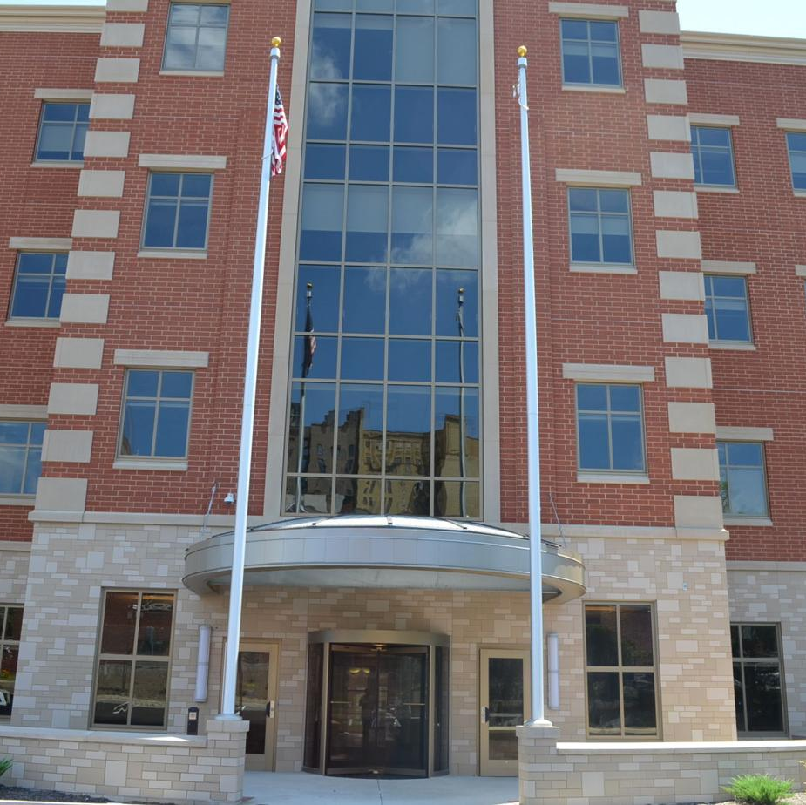
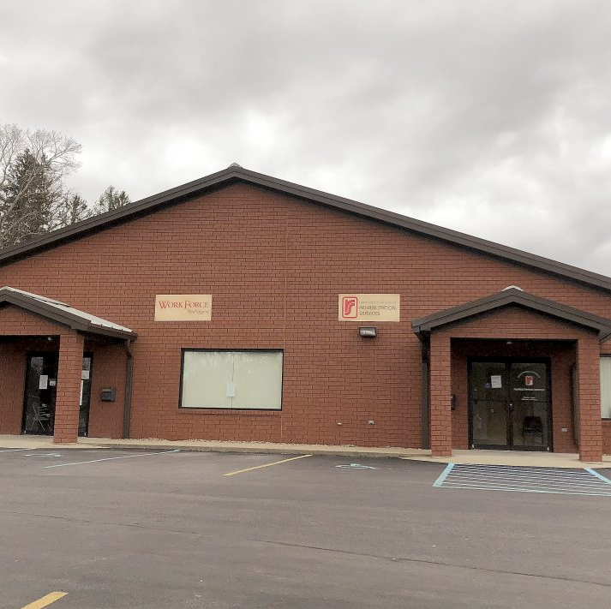
Fairmont
Morgantown
320 Addams St. Suite 103
Fairmont, WV 26554
40 Commerce Drive
Westover, WV 26501
Clarksburg
Elkins
153 West Main Street
Clarksburg, WV 26301
1023 N. Randolph Avenue
Elkins, WV 26241

Slide 3
IT’S THE LAW!
The Workforce Innovation and Opportunity Act (WIOA), is the first legislative reform of the public workforce system in 15 years. The law supersedes the Workforce Investment Act of 1998.
WIOA authorizes the one-stop career centers (also known as AMERICAN JOB CENTERS), which directly provide an array of employment services and connect customers to work related training and education, as well as the support services they need to get good jobs and stay employed.
Additionally, helping businesses find skilled workers and access other support, including education and training for their current workforce.
See WIOA – General Guidance for One-Stop Operations – Training and Employment Guidance Letter (TEGL) No. 16-16 issued by the US Department of Labor:
https://www.dol.gov/sites/dolgov/files/ETA/advisories/TEGL/2017/TEGL_16-16.pdf

Slide 4
Who Are the Core AJC Partners?
WIOA TITLE I – Adult, Dislocated Worker and Youth Programs. Administered by the Region VI Workforce Development Board through a sub-contract with HRDF, Inc.
WIOA TITLE II – Adult Education and Family Literacy Act Programs. Administered in Region VI by Mountain State Educational Services Cooperative.
WIOA TITLE III – Wagner-Peyser Act programs. Administered by the State Offices of Workforce West Virginia.
WIOA TITLE IV – Vocational Rehabilitation Programs. Administered by the State Offices of West Virginia Division of Rehabilitation Services.

Slide 5
Who Are the Other AJC Partners?
YouthBuild | Title I – Indian & Native American Programs
National Farmworker Jobs Program | Job Corps
Senior Community Service Program | Trade Adjustment Assistance Activities
Jobs for Veterans State Grants | Unemployment Compensation
Re-entry Employment Opportunities | Career & Technical Education Programs
Community Services & Block Grant E&T | Temporary Assistance to Needy Families
HUD Employment and Training | Second Chance Act
*Additional partners of a variety of appropriate Federal, State or local programs may be included with the approval of the Local Workforce Development Board and Chief Elected Officials.*
LOCAL BOARDS are responsible for:
negotiating and regularly reviewing a Memorandum of Understanding (MOU) with every one-stop (AJC) partner to describe operations, services provided and coordinated, funding and referrals.
Region VI Workforce Development Board updates MOU and Infrastructure Funding agreements annually.
ALL PARTNERS ARE REQUIRED to share in the funding of services and infrastructure costs of the one-stop delivery system.

Slide 6
We Are Partners…. NOW WHAT?
Vision of WIOA Partnerships in American Job Centers:
Provide access to all partner programs or services through the AJC network, in addition to other appropriate locations by having appropriately trained partner staff physically present at the AJC or a direct linkage through technology to program staff who can provide meaningful information or services;
Connect all customers to the full range of services available throughout their communities (Region 6 maintains a Region 6 Partner Resource Binder with information on all partner programs - this binder can be found on the Region VI Workforce Development website at www.regionviwv.org under American Job Centers TAB ) (Referrals to “No Wrong Door” can also be utilized as a source for statewide resources – https://nowrongdoor.wv.gov ; and well as West Virginia 211 – https://wv211.org
Provide seamless, customer-focused, integrated service deliver across all programs and enhance access to the programs’ services.
Ensure that businesses and job seekers have access to information and services that lead to positive employment outcomes.
Include the AJC Network Common Identifier or Tag Line on all primary electronic resources used by the one-stop delivery system, and on any printed, purchased or created materials in accordance with the One Stop System Common Identifier Policy 300-07 on the WV State Board Website -https://workforcedb.wv.gov/Documents/Policy%20300-07%20Common%20Identifier%20Final.pdf

Slide 7
Common Identifiers for Partner Locations
OR

Slide 8
What Are Some of The Biggest Challenges?
Getting the core program partners to share a vision and step out of their silos to accomplish it;
Getting all partners to engage with the One-Stop Operator and Local Board in a meaningful way that emphasizes the benefits of partnering;
Getting all partners to comply with the streamlining processes put into place by the One Stop Operator, such as customer service satisfaction surveys, co-enrollment of participants, referral processes, Needs assessment intake forms, participation in cross trainings, participation in quarterly partner meetings, volunteering for AJC events, etc.
Getting ALL partners to contribute their share to the funding of shared services, one stop contract and infrastructure costs.

Slide 9
One Stop Operator / Coordinator
Local Boards are responsible for selecting a One Stop Operator/Coordinator through a competitive process. The Human Resources Development Foundation, Inc. (HRDF, Inc) is the current Region VI One Stop Operator and Sydney Stansberry is currently the One-Stop Coordinator. Her contact information is sstansberry@hrdfwv.org Some of the duties of the One-Stop Coordinator are listed below - the full list is outlined in the Region VI MOU:
Convening Partnership meetings;
Assisting the Partner Network in coordinating the development of training and communication plan for the One-Stop System comprehensive and affiliate centers;
Leading and convening partners in the design and implementation of functional integration of services of the One-Stop System;
Promoting the services available through the One-Stop System, including the development of marketing and outreach materials with support and final approval from the Region VI WDB;
Evaluating customer needs and satisfaction data to continually refine and improve service strategies, including exploring implementing a real-time customer feedback model;
Serving as a liaison between the Region VI WDB and the Partner Network;
Ensuring that the Region VI WDB’s policies and procedures are effectively communicated and carried out through the One-Stop System;
Working with the Partner Network and the Region VI WDB to define and provide a means to meet common operational needs, such as training, technical assistance, and additional resources, etc.; Facilitating sharing of data and information; Email communications and Facebook Posts.

Slide 10
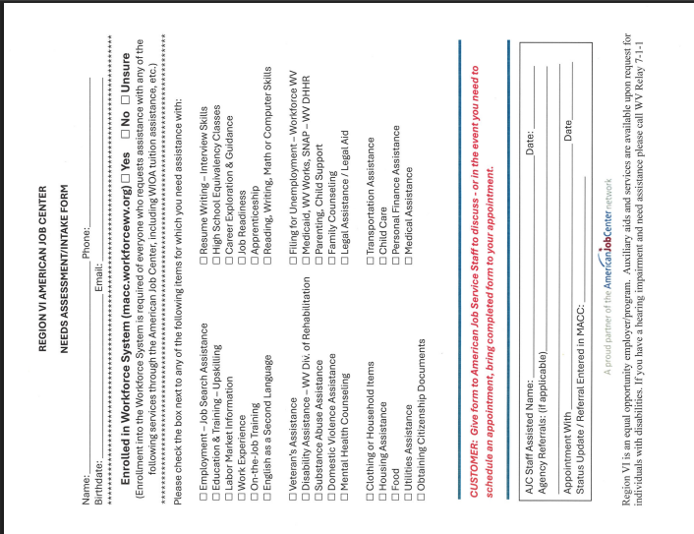
Needs Assessment/ Intake Form
The “new” Region 6 Needs Assessment/Intake form can be used by any AJC Partner as a tool to determine the needs of the customers they are serving or anyone who walks into AJC partner offices.
The Form provides a comprehensive list of support services offered by our Region 6 AJC Partners and Community Organizations.
Partner staff can use the completed form to determine what partner/organization referral needs to be made on the customer’s behalf.
The Region 6 Partner Resource Binder, WV 211 or No Wrong Door website can be utilized to determine the appropriate partner/agency referral.

Slide 11
Common Referral Forms
The Department of Labor requires all partners to participate in the use of a common referral process.
This form is to be used when referring clients to other partners in the Region VI American Job Center network.
Originals will go with the customer, after a copy is sent via email to the One Stop Coordinator.

Slide 12
Customer Satisfaction Surveys
Should be handed to every client that is served at the AJC’s.
Can be placed anonymously in the survey boxes located at every AJC or collected by staff.
One Stop Coordinator will also pick up during monthly site visits.

Slide 13
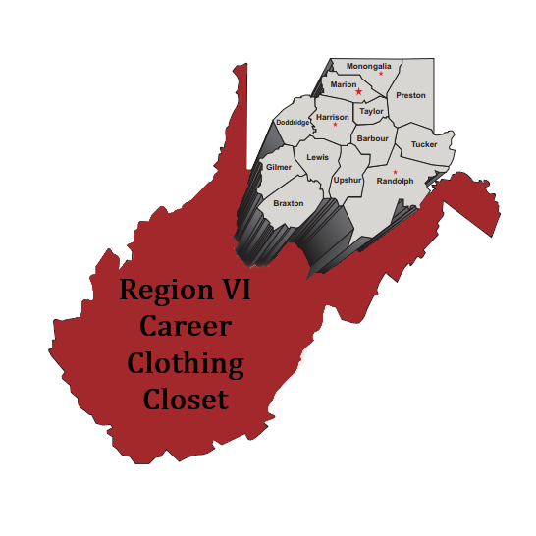
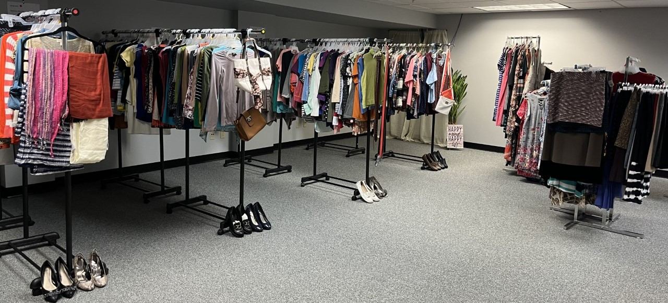
Partner Participation is highly recommended at all events such as Career Clothing Closet, AJC Mobile Events, etc.…
Region VI has started utilizing Mobile American Job Center pop-up events. These Mobile AJC events provide individuals throughout our region the opportunity to learn what partner programs and services are offered at our local AJCs. The AJC Outreach Committee determines where and when the next event will occur.
Jobseekers can access the closet once a month and select 2 complete outfits free of charge, with a partner referral.
Located at
320 Adams Street, Fairmont, WV 26554
Phone: 681-404-6377

