Slide 1
The Fair Housing Act
Vickie Ashcraft,
Fair Housing Education &
Outreach Coordinator
The Fairmont-Morgantown Housing Authority
vashcraft@fmhousing.com
304-363-0860 ext. 121
MISSION: Transforming our communities and empowering people through housing opportunities.

Slide 2
Acknowledgement/Disclaimer
The work that provided the basis for this publication was supported by funding under a grant with the U.S. Department of Housing and Urban Development. The substance and findings of the work are dedicated to the public. The author and publisher are solely responsible for the accuracy of the statements and interpretations contained in this publication. Such interpretations do not necessarily reflect the views of the Federal Government.

Slide 3
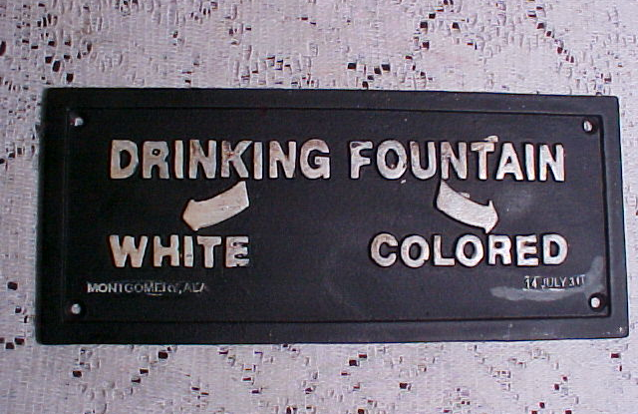
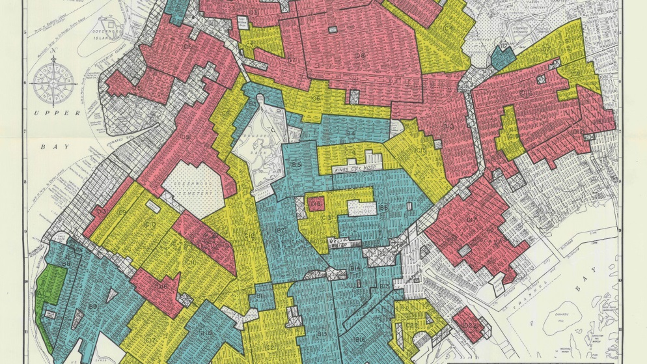
Historical Facts:
The Civil Rights Act of 1866
Plessy v. Ferguson (1896):
Home Owners’ Loan Corporation and Redlining (1933)

Slide 4
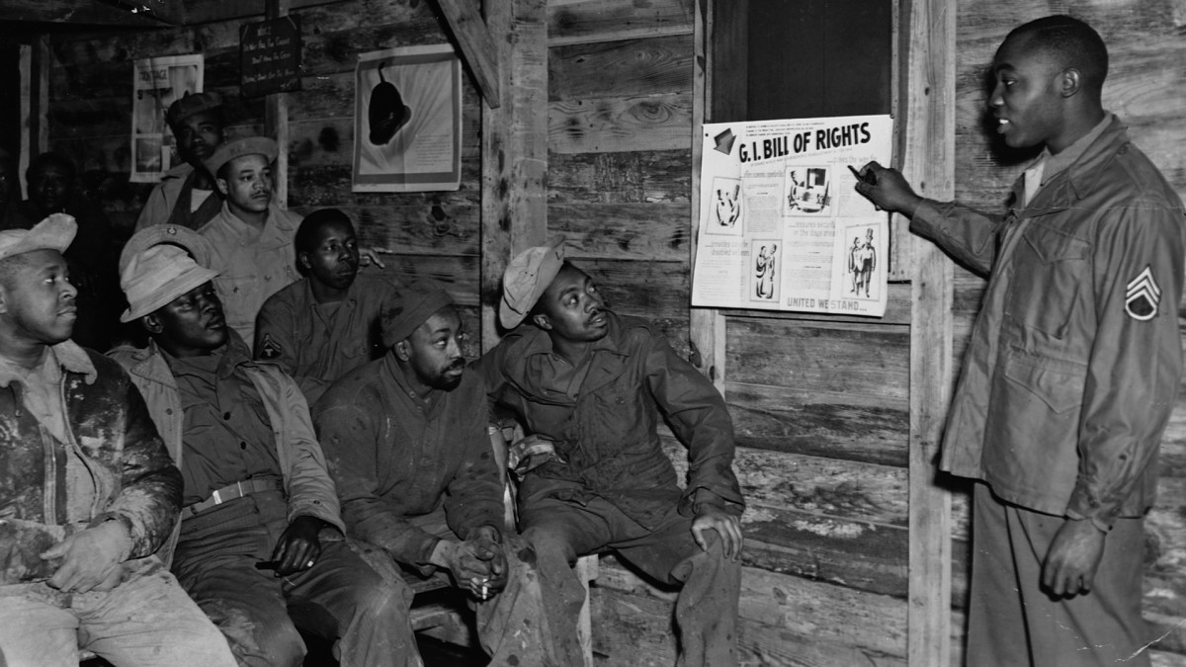
Black WWII Veterans & Redlining
The Serviceman’s Readjustment Act of 1944:
Banks refused loans to
Black veterans
Blacks were not allowed to
live in certain suburbs
On-the-job training and education given to Whites first
Notes:
Mississippi Senator Rankin insisted the GI bill be administered by the individual states in lieu of the federal government
Used his position as chair of the House Veteran’s Committee to do so. He was known to openly oppose desegregation, interracial marriage and proposed legislation to detain, segregate and deport Japanese Americans during WWII

Slide 5
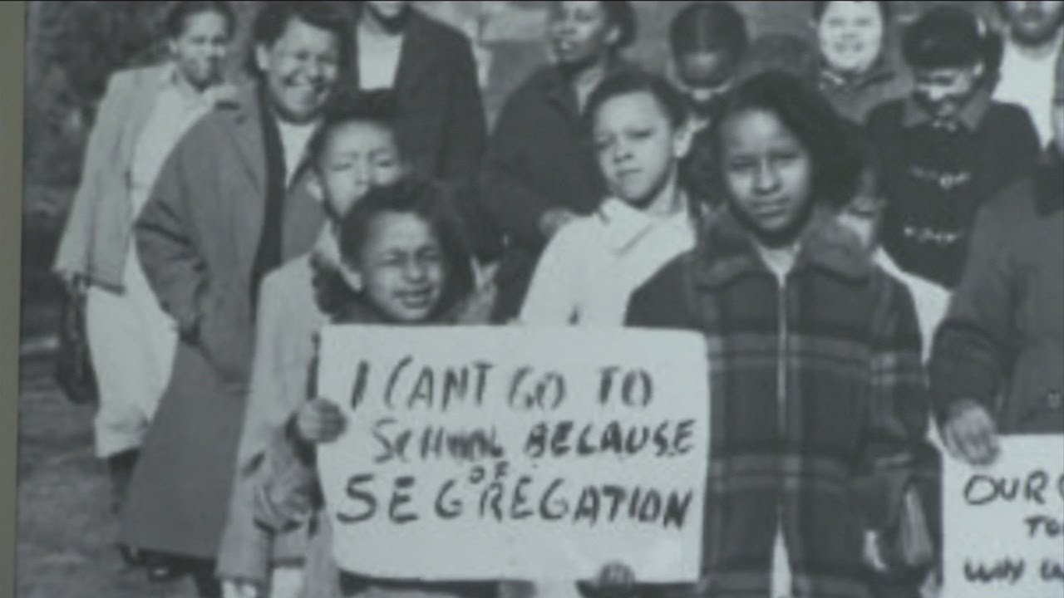
Historical Facts: The Tides Turn
Shelly v. Kramer (1948)
Brown v. Board of Education (1954)
The Civil Rights Act of 1964

Slide 6
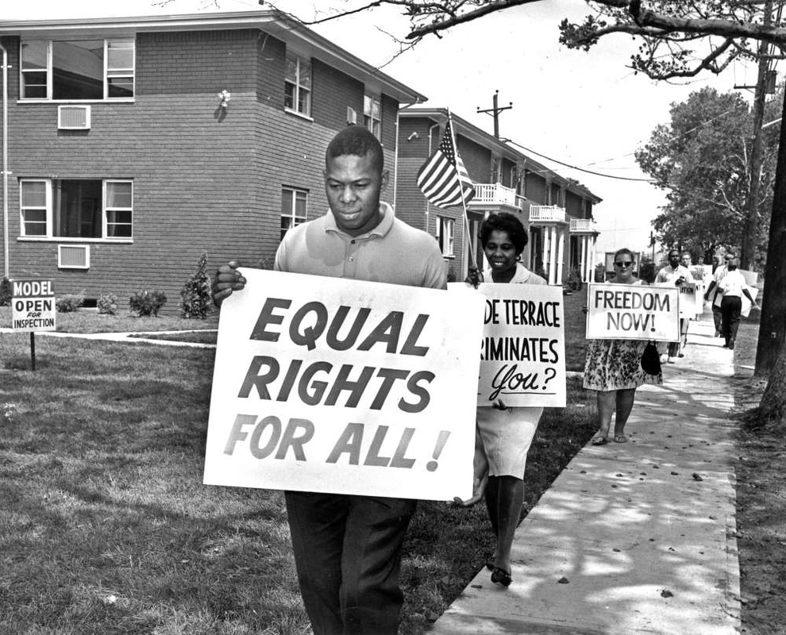
Historical Facts: The Tides Turn (cont’d)
The Civil Rights Act of 1968
Title VIII of the Civil Rights Act is the Fair Housing Act

Slide 7
What is Fair Housing?
Fair Housing means:
EVERYONE has the right to equally access housing.
Fair Housing for All: It’s Not Just a Right, it’s the Law!

Slide 8
What is Covered by the Fair Housing Act?
Covered issues include:
Renting/Buying
Houses/mobile homes/condos/land
Terms/Conditions
Reasonable Accommodations/Modifications

Slide 9
What is Covered by the Fair Housing Act? (cont’d)
Loans, Appraisals, Insurance
Advertising

Slide 10
Who Must Comply with the Fair Housing Act?
Who is Legally Bound to follow the Fair Housing Act?:
Anyone:
Selling/renting homes
Developing/building new homes
Lending money for homes (banks/mortgage lenders)
This Photo by Unknown Author is licensed under CC BY-NC

Slide 11
Who Must Comply with the Fair Housing Act? (cont’d)
Insuring homes (property/hazard insurance)
Zoning, municipal services
Anyone in advertising media

Slide 12
Examples of Who Must Comply
Property Owners/Managers
Maintenance staff
Real estate brokers/agents
Homeowners’ Associations, Condo Associations
Housing Authority staff

Slide 13
Examples of Who Must Comply (cont’d)
Housing developers/contractors
Mortgage lenders/financial institutions
Advertising media (verbal or written, including online)

Slide 14
Federally Protected Classes
As of 1968-
Race, Color, Religion, National Origin.
As amended in 1974-
Sex. (gender)
As amended in 1988-
Disability, Familial Status.

Slide 15
Federally Protected Classes (cont’d)
The Fair Housing Act began the process of investigating, resolving and hearing discrimination complaints.

Slide 16
West Virginia State Law & Protected Classes
As of 1992, West Virginia added two (2) protected classes to state law:
Blindness
Ancestry

Slide 17
Federally Protected Classes
Race
Sex (gender)
Religion
National Origin
Disability
Familial Status
Color
Notes:
Q&A

Slide 18
What is Discrimination Under the Fair Housing Act?
Discrimination: being treated differently
not all discrimination is illegal

Slide 19
What is Discrimination Under the Fair Housing Act? (cont’d)
Three (3) types of illegal discrimination:
When there’s a covered issue + a covered bases (protected class)
When person with a disability is denied
a reasonable accommodation
or modification
Discriminatory effect:

Slide 20
Protections Offered Under the Fair Housing Act
Renting:
Cannot be refused housing based on protected classes
Cannot be given different terms, conditions, or privileges of renting
Cannot keep the protected classes from housing of their choice

Slide 21
Protections Offered (cont’d)
Buying:
Lenders cannot refuse a loan, or homeowners’ insurance policy
Lenders cannot give renters different terms, conditions, interest rates, points or fees
Appraisals cannot be different because of race or sex

Slide 22
Protections Offered (cont’d)
Servicers cannot refuse to purchase a loan
Lenders cannot advertise any material that states a preference: verbal, written, online

Slide 23
Tenants’ & Buyers’ Rights
Right to habitable home
Right not to be charged large or overpriced security deposits
Right to reasonable level of privacy

Slide 24
Tenants’ & Buyers’ Rights (cont’d)
Right to reasonable accommodations/reasonable modification
Right to have SSI /SSDI income on mortgage application
Right to loan modification assistance
Right to apply for a mortgage while on maternity leave

Slide 25
Fair Housing Act Exemptions
“Mrs. Murphy” exemption owns four (4) of fewer units, owner lives in one
Single-family Exemption: houses For Sale By Owner without a real estate broker/agent
**State and local laws apply

Slide 26
Fair Housing Act Exemptions (cont’d)
Housing owned by a religious group or
private club
Housing that is kept for older individuals
**State and local laws apply

Slide 27
Definition of Disability Under the Fair Housing Act
Disability:
a physical or mental impairment limiting one (1) or more major areas of life; or

Slide 28
Definition of Disability Under the Fair Housing Act (cont’d)
having a history of a disability; or
being viewed as having a disability.

Slide 29
Disabilities & the Fair Housing Act
Section 504 of the Rehabilitation Act of 1973
Additional Protections for Individuals with Disabilities

Slide 30
Disabilities & the Fair Housing Act (cont’d)
Multifamily homes built after March 13, 1991, also must have features to help disabled people live in them

Slide 31
Reasonable Accommodation
A change, exception, or adjustment to a rule, policy, practice, or service made for a person with disabilities.
No Construction Required

Slide 32
Reasonable Modification
A structural change to a home that helps a person with disabilities.

Slide 33
Assistance Animals
Not limited to a dog
Doesn’t have to be trained
No pet deposit or pet rent

Slide 34
Assistance Animals (cont’d)
No weight limits
No pet liability insurance required
Example of reasonable accommodation

Slide 35
Assistance Animals (cont’d)
Assistance animals are NECESSARY
Verifying disability
If an Assistance animal causes damage, the tenant is responsible for repairs

Slide 36
Dos and Don’ts of Verifying Disability
Landlords CAN ask:
Can you pay rent?
Do you have rental references?
Will you follow the rules?
Do you have a criminal background?

Slide 37
Dos and Don’ts of Verifying Disability (cont’d)
Landlords CANNOT ask :
What is the type or severeness
of your disability?
Do you take medicine?
Can I see your medical records?
Can I talk to your doctor?

Slide 38
When Should a Reasonable Accommodation or Modification be Granted?
Reasonable accommodations or modifications are ALLOWED when:
the person is disabled
there is a relationship between the disability and the request

Slide 39
When Should a Reasonable Accommodation or Modification be Granted (cont’d)
Requests can be DENIED when:
requires large, unfair cost in money or administrative
time
requires duties beyond the day-to-day business
Should be reviewed on a case-by-case basis
This Photo by Unknown Author is licensed under CC BY-NC

Slide 40
Exceptions to Reasonable Accommodations
Other Reasons to Deny the Request:
Would threaten the health and/or safety of others
Would cause physical damage to others’ property
Points to Remember:
Another accommodation should be considered BEFORE denying request

Slide 41
Exceptions to Reasonable Accommodations (cont’d)
Reasonable accommodations or modifications “balance the scales” & provide equal access to all renters
not answering = denial

Slide 42
The Fair Housing Act & The LGBTQ+ Community
Sexual orientation and gender identity are NOT protected classes under the Fair Housing Act; but some situations are covered under the Fair Housing Act.
Disability

Slide 43
The Fair Housing Act & The LGBTQ+ Community (cont’d)
Sex/gender:
Denied because the possible renter doesn’t fit “gender stereotypes” is illegal discrimination.

Slide 44
The Fair Housing Act & the LGBTQ+ Community (cont’d)
The Fair Access Rule (March 5, 2012):
Functions of the Fair Access Rule:
For more information: Visit HUD’s website: www.hud.gov/fairhousing

Slide 45
Familial Status & the Fair Housing Act
Definition:
the presence of children under the age of 18

Slide 46
Familial Status & the Fair Housing Act (cont’d)
Dos & Don’ts :
Do not refuse families housing unless housing units are for senior housing
Do not refuse to rent to families because of safety concerns

Slide 47
Housing for Older Persons Act & The Fair Housing Act
Facility labeled by the HUD secretary as housing for elderly and/or elderly and disabled
62+ years old housing:
55+ years old housing:

Slide 48
Advertising & the Fair Housing Act
Advertising is anything written or verbally stated:
Newspaper (digital/print)
Post-it notes on a bulletin board
Conversations with possible renters on the phone

Slide 49
Advertising & the Fair Housing Act (cont’d)
Examples of Permissible Phrases in Advertising:
Master bedroom
Mother-in-law suite
Female roommate wanted**
**shared living is clearly stated,
other protected classes’
rules apply

Slide 50
Advertising & the Fair Housing Act
Examples of Inadmissible Phrases in Advertising
White family home
Adult community
Roselawn Catholic Home**
(**non-discrimination statement is required)
DESCRIBE THE UNIT FOR RENT, NOT THE OCCUPANT

Slide 51
How Do I File a Fair Housing Complaint
How does one file a complaint if one feels they have been discriminated against?
Can file online utilizing HUD Form 903 Online Complaint (Submit on website)
Download the complaint form and email completed form to the Office of Fair Housing and Equal Opportunity (FHEO)
Phone an FHEO intake specialist by calling: 1-800-996-9777 or
1-800-877-8339; list of regional FHEO is available online
Mail form (download HUD Complaint Form) Send to regional FHEO office:
WEST VIRGINIA RESIDENT CONTACT REGION III FHEO OFFICE AT :
Philadelphia Regional Office of FHEO
US Department of Housing and Urban Development
The Strawbridge Building
801 Market Street
Philadelphia, PA 19107
Phone: (215)861-7646
Toll Free: (888)799-2085
TTY: (215)656-3450
Email: Complaints_office_03@hud.gov
***complainant can request language assistance if they are limited in English
proficiency

Slide 52
How Do I File a Complaint (cont’d)
WV Human Rights Commission
Website: www.hrc.wv.gov
Address: 1321 Plaza East, Room 108A
Charleston, WV 25301
Phone: (304)558-2616
(888)676-5546
Local HUD certified Housing Counselor is:
Theressa Nichols
The Fairmont-Morgantown Housing Authority
103 12th Street
Fairmont, WV 26554
Phone: (304)363-0860 ext. 127
Email: tnichols@fmhousing.com

Slide 53
HUD FORM 903

Slide 54
Q&A and Wrap Up
Parking Lot issues (not directly related to the Fair Housing Act)
Questions & Answers
Presentation Survey

