Slide 1
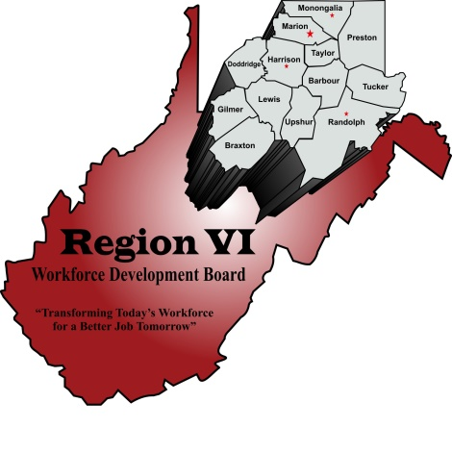
YouthReady
Region 6 - WIOA Youth Program

Slide 2
What is the WIOA Youth Program?
The WorkForce Innovation and Opportunity Act (WIOA) Youth Program is designed to assist low-income youth achieve their educational and employment goals. If eligible, participants work with a Service Placement Specialist to create a personalized plan for a successful future.

Slide 3
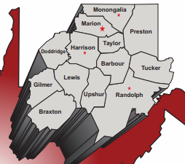
What counties does Region 6 serve?
Barbour
Braxton
Doddridge
Gilmer
Harrison
Lewis
Marion
Monongalia
Preston
Randolph
Taylor
Tucker
Upshur

Slide 4
What services does the WIOA Youth Program Provide?
Participants enrolled in this program can take advantage of the 14 core services.
Paid and Unpaid Work Experiences
Tutoring, Study Skills Training, Dropout Prevention Strategies
Occupational Skills Training
Alternative Secondary School offerings/Dropout Recovery Services
Comprehensive Guidance and Counseling
Integrated Education and Occupational Training
Financial Literacy Education
Entrepreneurial Skills Training
Leadership Development Activities
Supportive Services
Adult Mentoring
Follow-up Services
Post-secondary Preparation
Labor Market Information

Slide 5
Who is eligible for the WIOA Youth Program?
Individuals aged 16 to 24 and not attending school AND
Fall within one or more of the following categories:
Individual with a disability
School dropout
Not attended school for at least the most recent complete school year calendar quarter.
A high school graduate who is: basic skills deficient; low income, or an English language learner.
Offender
Homeless, runaway, or foster child
Pregnant or parenting
A low-income individual who requires additional assistance to enter or complete an educational program or to secure or hold employment

Slide 6
Supportive Services Offered in Region:
Training-Related Needs-Based Payments:
Youth receive a $5.00 per hour training- related needs-based payment for each hour spent in classroom training or unpaid work activities, such as: Occupational Exploration, internships, and community services.
TASC Attainment Incentive
Youth receive a $100.00 incentive for receiving their TASC. Successful completion will be documented by the attainment of a diploma.
Measurable Gains Bonus
Youth receive a $50.00 and $25.00 bonuses for increasing their TABE levels, receiving a promotion at work, completing additional certificates, obtaining their driver's license...and other steps that lead to self-sufficiency.
Additional Assistance
The program covers costs associated with testing, certification and lab fees. Staff can assist with resources needed to go to work, such as specialized tools or clothing.

Slide 7
Region 6 WIOA Youth Program Office Locations:
Fairmont Office
320 Adams Street, Suite 103
Fairmont, WV 26554
Phone: (304) 365-3146
Counties served:
Monongalia, Marion, and Preston
Contact: Suzanne Lewis
Clarksburg Office
153 West Main St. Suite B
Clarksburg, WV 26301
Phone: (304) 657-5698​
Counties Served:
Doddridge, Lewis, Harrison and Taylor
​Contact: Bethany McBee
Office
115 Main Ave.
Weston, WV 26452
Phone: (304) 940-3966
Counties Served:
Barbour, Braxton and Gilmer
Contact: Trecie Coleman
Elkins Office
1200 Harrison Ave., Suite 103
Elkins, WV 26241
Phone: (304) 637-0718
Counties Served:
Randolph, Tucker, and Upshur
Contact: Crystal Replogle

Slide 8
Region 6 WIOA Youth Program – YouthReady
To learn more about the WIOA Youth Program, contact the office for the county you are located in.

